Slide 1
BITS Pilani
Prof.Aruna Malapati
Asst Professor
Department of CSIS

Slide 2
Statistical Constituency Parsing

Slide 3
Today’s Agenda
Probabilistic Context Free Grammar(PCFG)
Finding the best parse tree
Issues with PCFGs
Lexicalized PCFGs

Slide 4
Formal Definition of a PCFG
A PROBABILISTIC context-free grammar G is defined by four parameters: N, Σ, R, S.
R is a set of production rules, each of the form A → β [probability]
S → NP VP [0.8]
S → Aux NP VP [0.15]
S → VP [0.05]
For a rule A → B C , the probability can be represented
P(A → B C ) or P(A → B C | A ) or P(RHS | LHS )

Slide 5
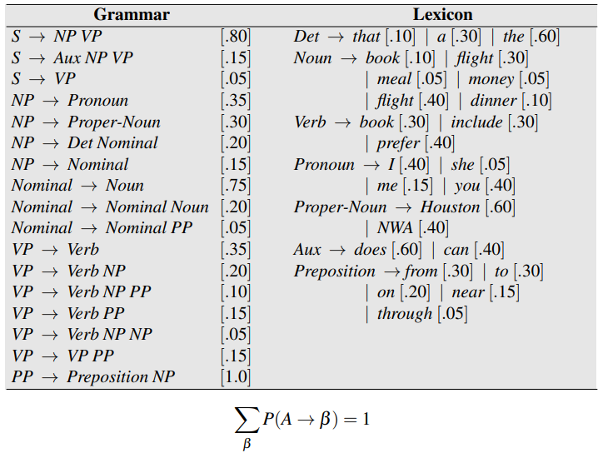
Example PCFG

Slide 6

Probabilistic CFGs
A PCFG assigns a probability to each parse tree T of a sentence S. This is useful in disambiguation, since we can pick the most likely parse tree.
The probability of a parse T is defined as the product of the probabilities of all the rules used to expand each of the non-terminal nodes in the parse tree

Slide 7
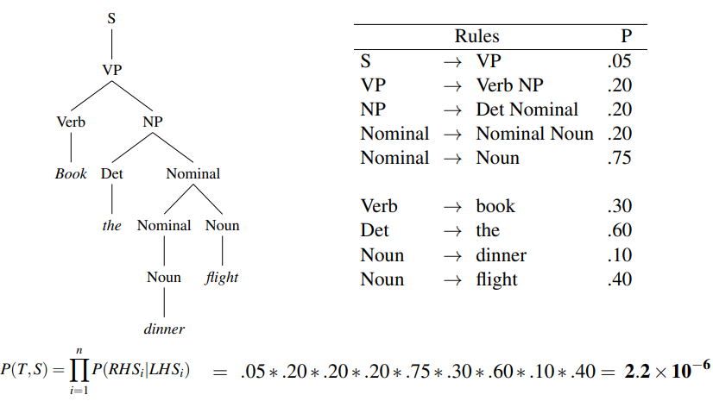
Probability of a parse

Slide 8
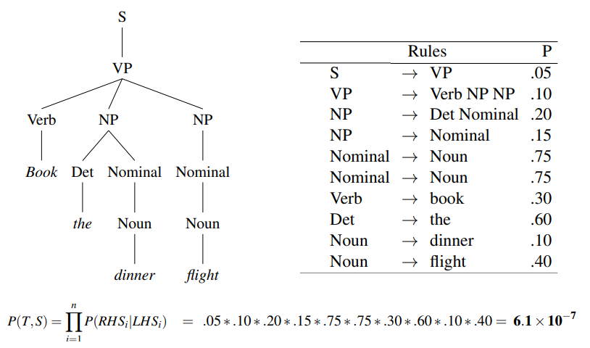
Probability of a parse

Slide 9
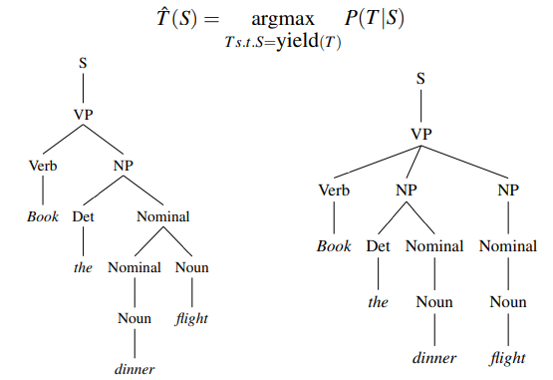
Finding the best Parse Tree
Pick the parse with the highest probability. Consider all the possible parse trees for a given sentence S. The string of words S is called the yield of any parse tree over S.

Slide 10
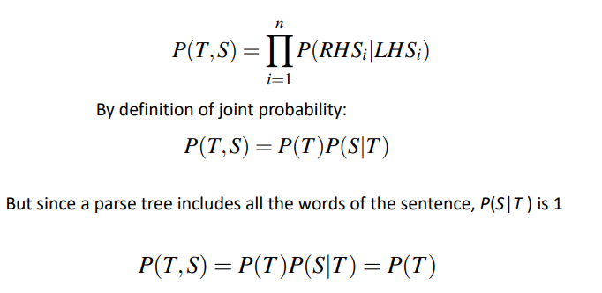
Joint Probability of T and S

Slide 11
Estimating the probabilities

Slide 12
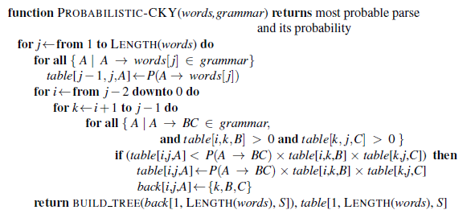
Probabilistic CKY Parsing of PCFGs

Slide 13

Example
 | The | flight | includes | a | meal
0
1
2
3
4

Slide 14
Problems
Lack of sensitivity to structural preferences
2. Lack of sensitivity to lexical information
Notes:
Poor independence assumptions: CFG rules impose an independence assumption on probabilities that leads to poor modeling of structural dependencies across the parse tree.
Lack of lexical conditioning: CFG rules don’t model syntactic facts about specific words, leading to problems with subcategorization ambiguities, preposition attachment, and coordinate structure ambiguities.

Slide 15
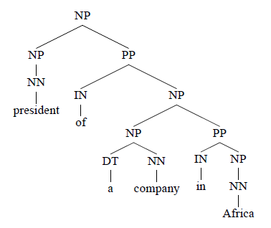
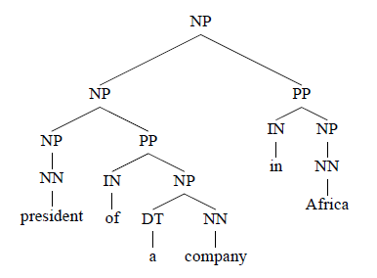
Lack of Sensitivity to Structural Preferences
Both parse trees have identical probabilities under a PCFG.
The PP in Africa can either attach to president or a company.

Slide 16
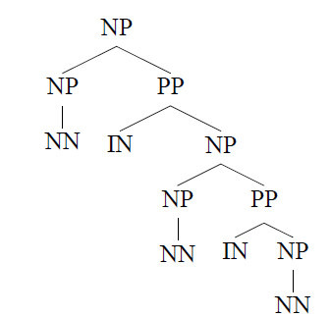
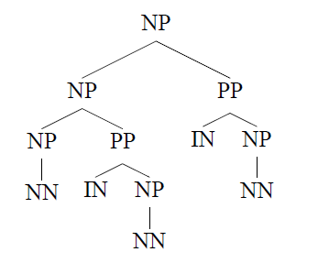
Lack of Sensitivity to Structural Preferences
close attachment
Statistics from the treebank show that structure 1 is roughly twice as frequent as structure 2 but PCFG assigns identical probabilities to these two trees

Slide 17
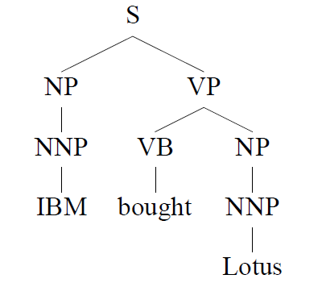
Lack of Sensitivity to Lexical Information
Under the PCFG model, this tree will have probability
q(S → NP VP) × q(VP → V NP) × q(NP → NNP) × q(NP → NNP) ×q(NNP → IBM) × q(Vt → bought) × q(NNP → Lotus)

Slide 18
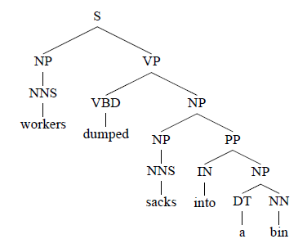
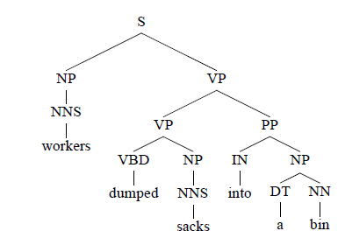
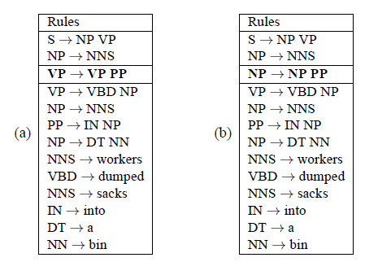
PP attachment ambiguity

Slide 19
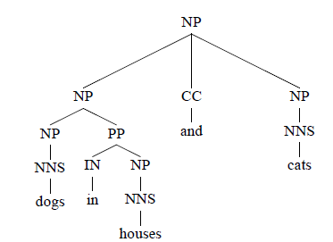
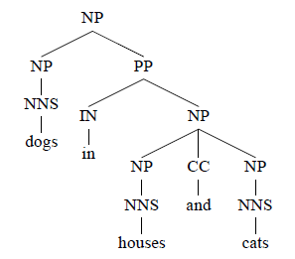
Coordination Ambiguity
Difference is in the order in which these rules are applied, Hence PCFG assigns same value to both trees.

Slide 20
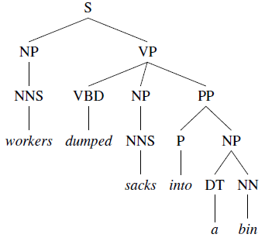
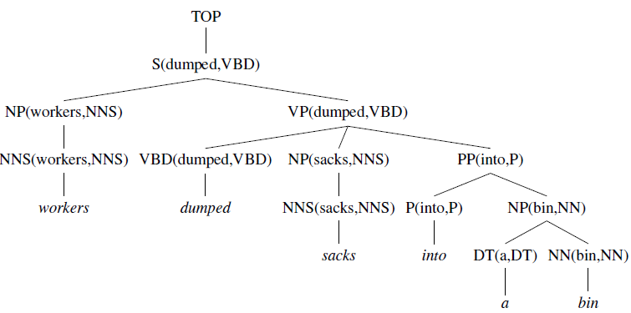
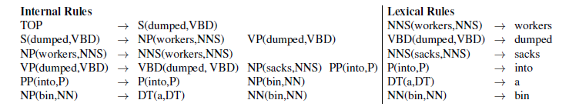
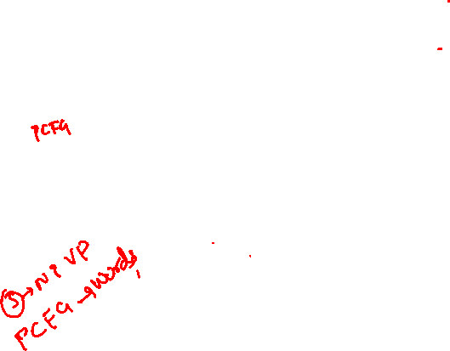
Lexicalization of a Treebank
Parse Tree after Lexicalization

Slide 21
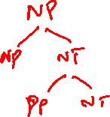
Lexicalization of a Treebank(contd..)
For each Context Free Rule of the form X->Y₁ Y₂ …. Y_{n}
an index h ϵ {1…n} that specifies the head of the rule.
The head of a Context Free Rule is most important child of the rule.
Examples
S -> NP VP (h=2)
NP -> NP PP PP PP (h=1)
PP -> IN NP (h=1)

Slide 22
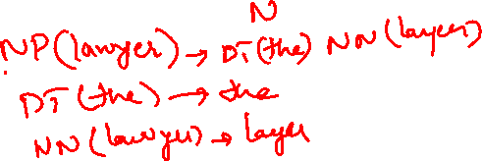
Lexicalization of a Treebank(contd..)
Lexical information can be propagated bottom-up through parse trees in the treebank.

Slide 23
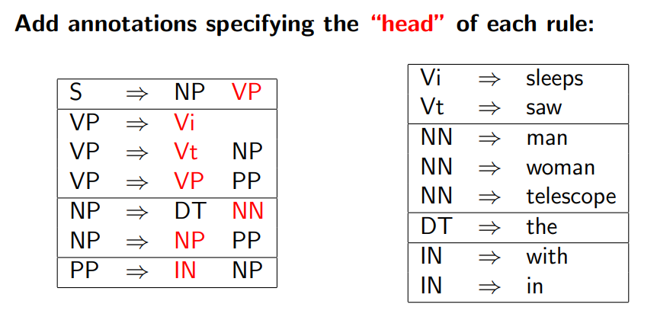
Heads in Context-Free Rules

Slide 24
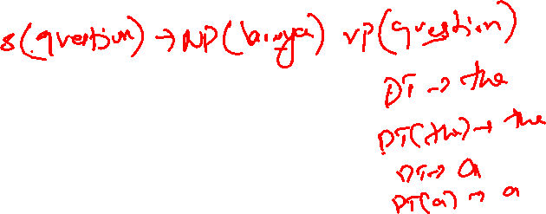
Lexicalized PCFGs
The basic idea in lexicalized PCFGs will be to replace rules such as S -> NP VP with lexicalized rules such as S(examined) -> NP (lawyer) VP (examined).

Slide 25
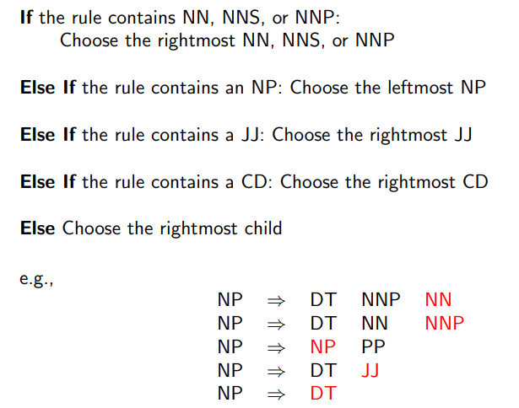
Rules which Recover Heads: An Example for NPs

Slide 26
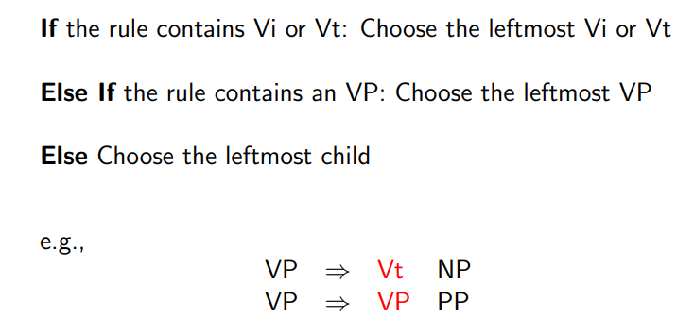
Rules which Recover Heads: An Example for VPs

Slide 27

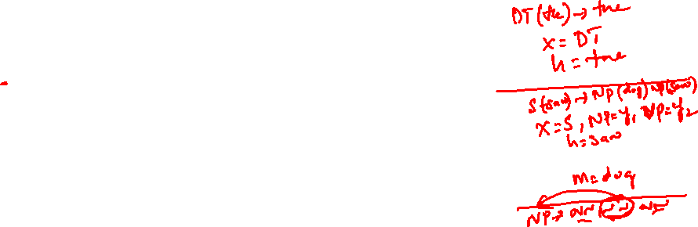
Lexicalized PCFGs (Contd..)
A lexicalized PCFG in Chomsky normal form is a 6-tuple G = (N,∑,R, S, q,γ ) where:
• N is a finite set of non-terminals in the grammar.
• ∑ is a finite set of lexical items in the grammar.
• R is a set of rules. Each rule takes one of the following three forms:
1. X(h) →1 Y1(h) Y2(m) where X, Y1, Y2 ∈ N, h,m ∈ .
2. X(h) →2 Y1(m) Y2(h) where X, Y1, Y2 ∈ N, h,m ∈ .
3. X(h) → h where X ∈ N, h ∈ .

Slide 28





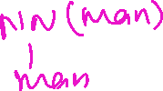



















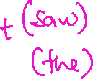

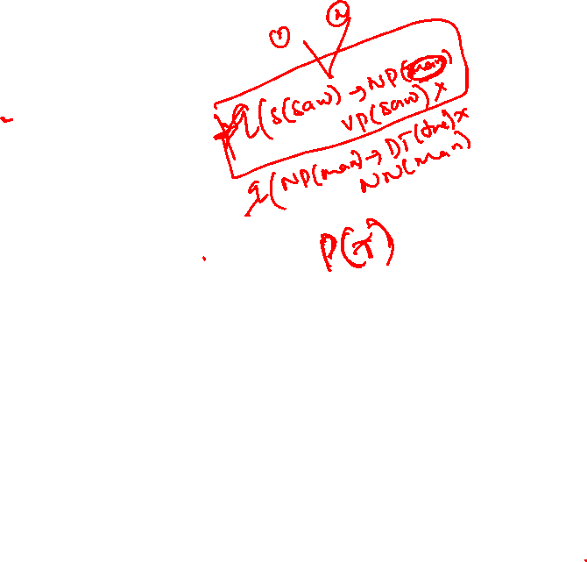

Example of parsing with lexicalized CGF

Slide 29
Lexicalized PCFGs (Contd..)
We now treat the lexicalized grammar exactly as a regular PCFG.
This results in a very large number of rules.
Each lexicalized rule will have an associate parameter, For example q( NP(layer) -> DT(the) NN (lawyer)).
The model will have huge number of parameters to be computed hence need a smarter way of estimating parameters.

Slide 30




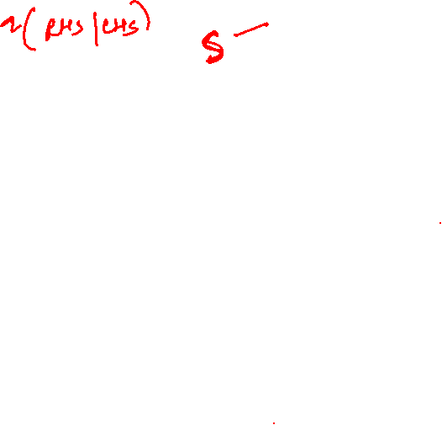

Parameters in PCFG
An example parameter in PCFG is q(S->NP VP)
An example parameter in Lexicalized PCFG is
q(S(saw)->NP(man) VP(saw))

Slide 31


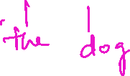


























Example

Slide 32





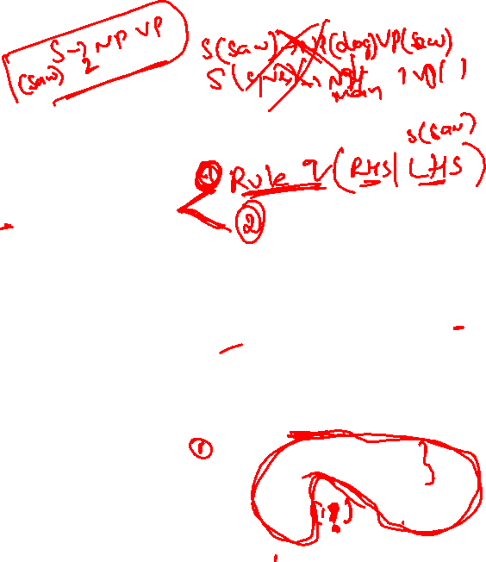




A model from Charniak
An example parameter in Lexicalized PCFG is
q(S(saw)->₂ NP(man) VP(saw))
Step1:Decompose this parameter into a product of two parameters.
q(S(saw)- NP(man) VP(saw))=q(S- NP VP S,saw)x
q(man. S- NP VP,saw)

Slide 33













































A model from Charniak

Slide 34

























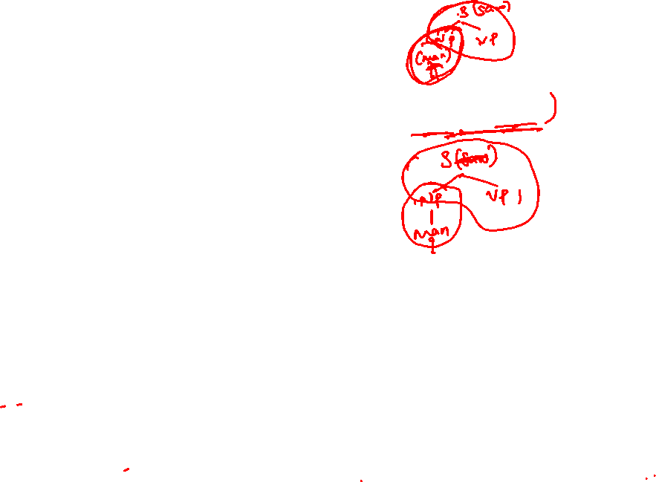





A model from Charniak

Slide 35









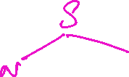






Evaluation

Slide 36





















Precision and Recall

Slide 37








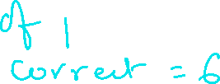











Precision and Recall

